Slide 1
Functions with Parameters
A supplemental lesson for AP CSP

Slide 2
Warm-up
Review what you already know about functions.

Slide 3
What is a function?
Function: A named set of instructions that accomplishes a task.
A function is a form of procedural abstraction.
Procedural Abstraction: A technique that breaks down complex tasks into smaller, more manageable procedures.

Slide 4
A function is procedural abstraction
A section or block of code that accomplishes a specific task.
Give the block of code a name.
This “hides” the details of completing the task – procedural abstraction.
Call the function by name when you want to execute the code.
The function can be called multiple times in a program.

Slide 5
When to use a function
When you first started using functions (Mission 3) you identified places in your code that were repeated.
You created a function for the repeated code.
Gave it a name
Coded the function
Called the function

Slide 6
A function is procedural abstraction
A function may also be created to:
Make a section of code adaptable and flexible
Let’s take a look at an example.
Log in to CodeSpace.
In the sandbox, open your Pixels1_RGB program.
Go to File → Save As… and rename the program Pixels1_parameters

Slide 7
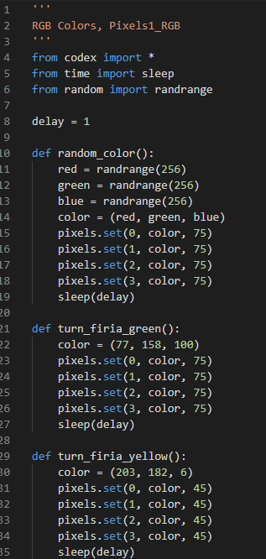
Example 1: Pixels1_RGB
This program has several functions.
They all do basically the same thing, just with different colors.
Can you create a single function that could handle all the colors?

Slide 8
Example 1: Pixels1_RGB
Yes! … if you give the function information – which color to change the pixels.
The information a function needs to complete its task is called a parameter.
With a parameter you can call a function many times and have it do something a little different each time, like turn the pixels a different color.

Slide 9
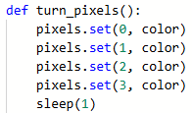
Example 1: Pixels1_RGB
Let’s change the program to use fewer functions, with parameters.
Create a new function called: turn_pixels()
Add code to the function that will turn each pixel the same color.
You can use either four lines of code, or a loop.

Slide 10
Example 1: Pixels1_RGB
Examine the new function.
Is there information the function needs to complete its task?

Slide 11
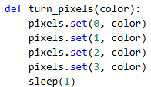
Example 1: Pixels1_RGB
It needs to know the color!
The color will be a parameter.
A parameter is always included in the function definition:
def turn_pixels(color):

Slide 12
Example 1: Pixels1_RGB
How does parameter get the information it needs?
The function call includes an argument.
An argument can be a literal value or a variable.

Slide 13
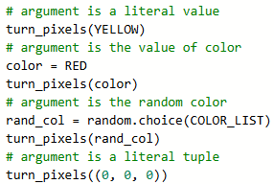
Example 1: Pixels1_RGB
These are examples of possible function calls with arguments.
The value of the argument is “passed” to the parameter, which acts as a variable in the function.

Slide 14
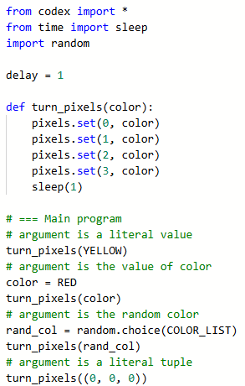
Example 1: Pixels1_RGB
Type the code as the main program.
Run the program and watch what happens.
Do you see the pixels turn the 4 indicated colors?
Note: You need to change the import random statement.

Slide 15
Example 1: Pixels1_RGB
Manage the complexity of your program by:
Calling the turn_pixels() function for each color, using the color as an argument; and
Deleting the functions that turn the pixels only one color.
You can keep a function that gets random colors (for now).

Slide 16
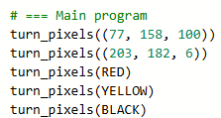
Example 1: Pixels1_RGB
For example:
All functions to the right can be replaced with these function calls:
Delete your functions like these!

Slide 17
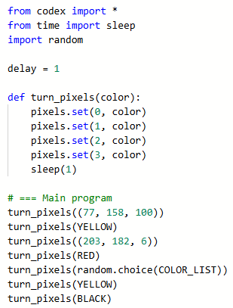
Example 1: Pixels1_RGB
So now your program has 1 function instead of 5!
And the function can be called multiple times, using any argument.
You no longer need to create a function for every color.
Procedural abstraction in action – managing complexity!

Slide 18
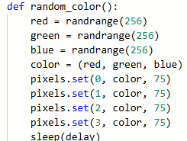
Example 1: Pixels1_RGB
Many of you have a function for selecting a random RGB color.
Can you use the turn_pixels() function for this task as well?

Slide 19
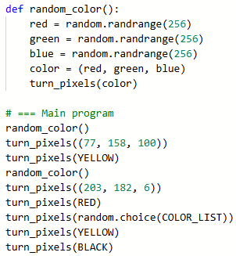
Example 1: Pixels1_RGB
Sure!
There are several ways you can do this.
One way is for the random_color() function to call the turn_pixels() function.
A function can call another function!
This manages complexity by removing duplicated code.

Slide 20
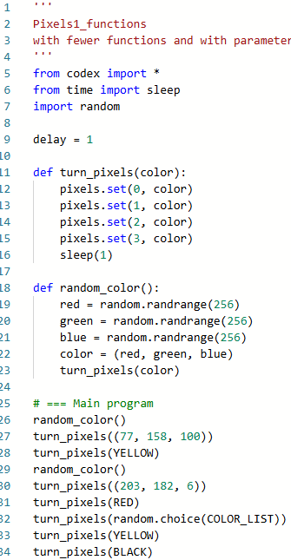
Example 1: Pixels1_RGB
Using a function with a parameter makes your code a lot shorter, and hopefully easier to read and follow.
Can we do even more?

Slide 21
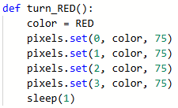
Example 1: Pixels1_RGB
Some of the functions you deleted may have used a brightness parameter.
A function can have more than one parameter.
Add another parameter to turn_pixels() for the brightness.

Slide 22
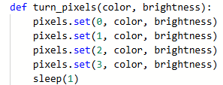
Example 1: Pixels1_RGB
Add the parameter in the function definition.
Use the parameter in the code block.

Slide 23
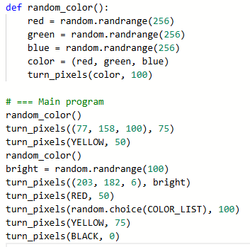
Example 1: Pixels1_RGB
Your function calls will now need to have two arguments.
The arguments need to be in the same order as the parameters!
The brightness argument can be a literal value or a variable.
An example is given.
Modify your code to include a brightness argument in each function call.

Slide 24
Example 1: Pixels1_RGB
How about one more parameter?
Add a parameter for the amount of delay in the sleep().
Use the parameter in the function block.
Three parameters!
You will also need three arguments, in the correct order.
The delay argument can be a literal value or a variable.
Do this modification on your own.
Now you can have a true light show, with just a little code!

Slide 25
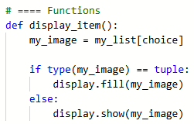
Example 2: Billboard_functions
Try adding a parameter to another program’s function.
In CodeSpace, open the program Billboard_functions in the sandbox.
Go to File → Save As.. and rename the file Billboard_parameter
The display_item() function doesn’t have a parameter.
But it does use a global variable: choice.
A global variable can still be a parameter.

Slide 26
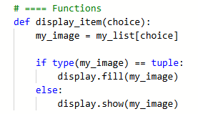
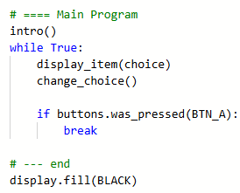
Example 2: Billboard_functions
Add a parameter for choice in the function definition.
Add an argument choice in the function call.
Run the program and check for errors.

Slide 27
Local Variables
Both functions with parameters also have local variables.
A local variable is declared and used only in a function.
Parameter
Local Variable

Slide 28
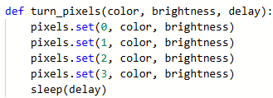
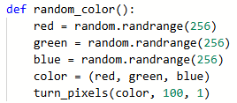
Local Variables
Look at the turn_pixels() and random_color() functions.
Identify the parameters and local variables.

Slide 29
Local Variables
Look at the turn_pixels() and random_color() functions.
Identify the parameters and local variables.
Parameters: color, brightness, delay
Local Variables: none

Slide 30
Local Variables
Look at the turn_pixels() and random_color() functions.
Identify the parameters and local variables.
Parameters: none
Local Variables: red, green, blue, color
Possible Function Call for random.randrange():
random.randrange(256)
Possible Function Call for turn_pixels():
turn_pixels(color, 100, 1)

